Slide 1
REINFORCEMENT PROJECT
NAVYATHASRI R DADS

Slide 2

Introduction
DATASET : DIRTY CAFE SALES DATASET
Objectives
Explore and understand the café datase
clean and prepare the data for reliable analysis. visualize data with charts for easy interpretation.

Slide 3
Data Understanding
Dataset: The project uses the Dirty cafe sales dataset
Data Sources: This is an internal dataset, likely from a cafe's point- of-sale system.
Key Attributes/Variables: The dataset includes Transaction ID, Item, Quantity, Price Per Unit, Total Spent, Payment Method, Location, and Transaction
Date.

Slide 4
Data Cleaning
The raw data contains missing values, incorrect data types, and inconsistent entries, which can lead to inaccurate analysis
The cleaning process included handling data types, addressing missing values, dropping duplicates, and identifying outliers

Slide 5
Handling Missing Values
The approach for handling missing values depended on the data type
Missing numerical values were replaced with the mean or median.
Missing categorical values were replaced with "UNKNOWN"

Slide 6

Outlier Handling
Outliers were identified using a combination of visualization and statistical methods.
Visualization: Box plots were used to visually identify outliers.
The Interquartile Range (IQR) method was used to define the lower and upper bounds for outliers. The lower bound was calculated as Q1 - 1.5 * IQR, and the upper bound as Q3 + 1.5 * IQR.

Slide 7
Handling Invalid Values
The dataset contained text values like 'ERROR' and 'UNKNOWN' in columns that should have numerical or specific categorical values.
For numerical data, invalid values were replaced with the mean or median.
For categorical daa, they were replaced with "Unknown".

Slide 8
Statistical Analysis
An One square t-test was used to see if the mean Total Spent differs across different Locations.
Chi-Square: A Chi-Square test was conducted to check for an association between Payment Method and Location

Slide 9
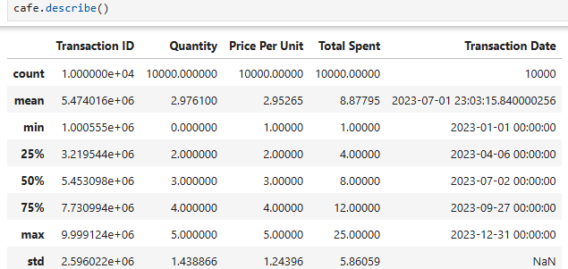
Descriptive Analysis

Slide 10
Relationships Batween Variables
The project analyzed the relationships between Item, Location, and Total Spent.
This analysis helped to understand which items sell best in which locations.

Slide 11
Data Visualization
The project analyzed the relationships between Item, Location, and Total Spent.
This analysis helped to understand which items sell best in which locations

Slide 12
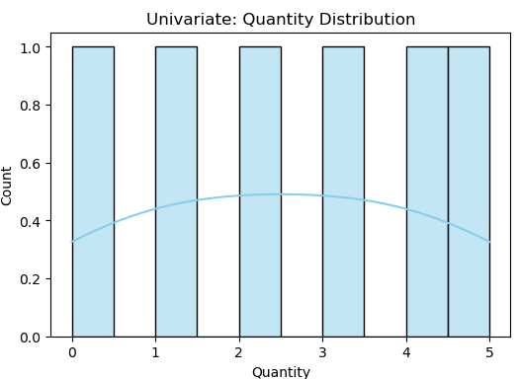
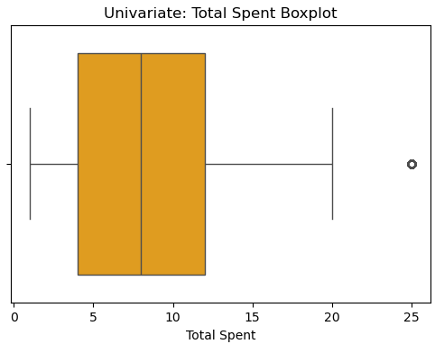
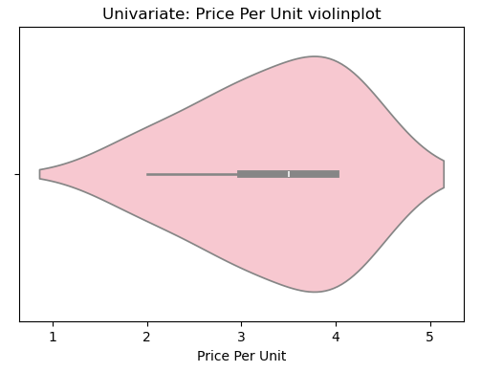
Univariate Analysis

Slide 13
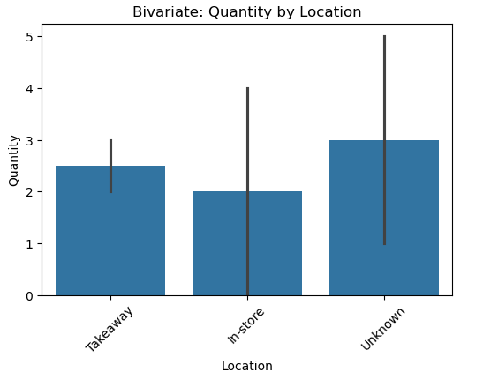
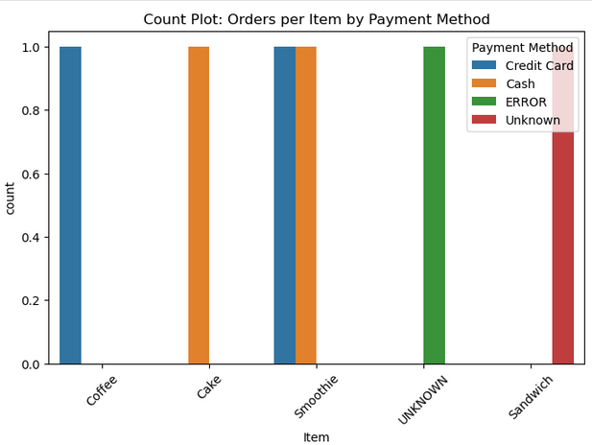
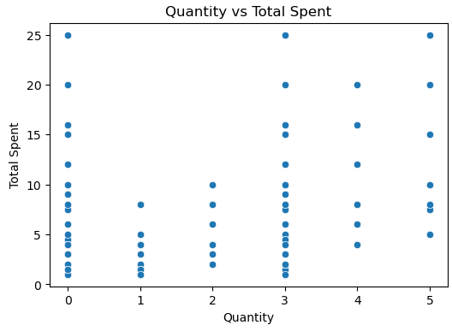
Bivariate Analysis

Slide 14
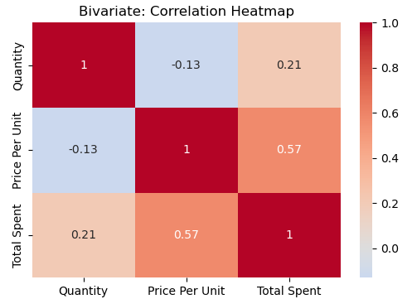
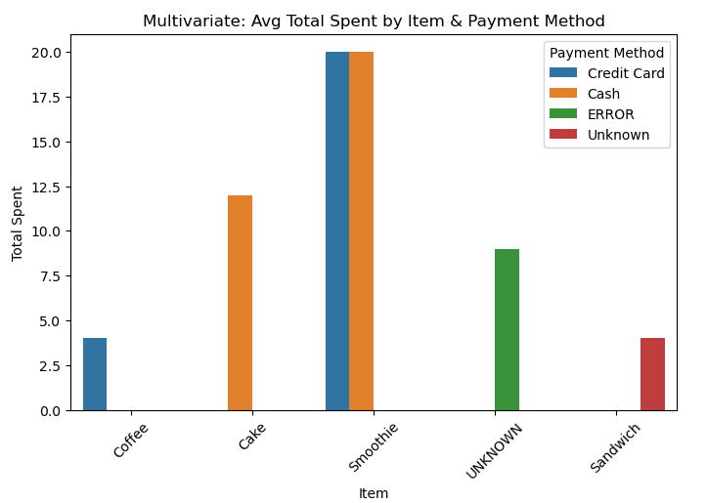
Multivariate Analysis

Slide 15
Conclusion and Recommandations
The analysis revealed that Coffee and Cake are the most popular items. In- store sales dominate, but the Takeaway channel offers a growth opportunity. Credit Card and Digital Wallet are becoming more popular payment methods
Recommendations:
Introduce seasonal specials, like new smoothie flavors in the summer.
Promote Takeaway orders with special offers to increase sales.
Encourage the use of preferred payment methods with discounts.

Slide 16
Thank You

